Slide 1

Trainer: Team Members: Mrs. Amrutha Kedar Chimote Ms. Sridurgadevi Ravikumar (EduBridge India Learning pvt.ltd) Ms. Pooja BC Batch : 2021- 2022
Minor project presentation on
Loan Approval Prediction

Slide 2
Presentation Outline:
Introduction
Objectives
Process and software specification
Result and Discussion
Conclusion

Slide 3
INTRODUCTION Loan Analysis is an evaluation method that determines if loans are made on feasible terms and if potential borrowers can and willing to pay back the loan. It checks the eligibility of the potential borrower against the criteria set forth for lending. Loan analysis helps in assessing the skills and financial knowledge of the borrower to determine the level of risk involved.

Slide 4
Objective:
The prime objective of our project is very clear from the project title itself. We want to predict whether an applicant can be approved of loan or not by applying machine learning techniques. Learn to deal with missing data. Learn to analyze given data by performing exploratory data analysis. Go through different machine learning algorithms and understand how they work. Finally build a machine learning model to predict loan approval.

Slide 5
Process and Software Requirement
Hypothesis Generation Missing Value And Outlier Treatment Exploratory Data Analysis Univariate Analysis Bivariate Analysis Model Building SVM Logistic Regression Prediction

Slide 6
Process Model
.
Gather known Data
and known response
Understand the dataset
Clean the dataset
Visualization
Train the Model
Fine tune the model
Use model with new data
For prediction

Slide 7


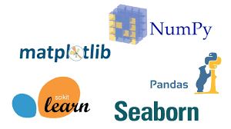
Software Requirement
Python Libraries Used: Jupyter Notebook NumPy Pandas Seaborn Matplotlib Scikit Learn

Slide 8
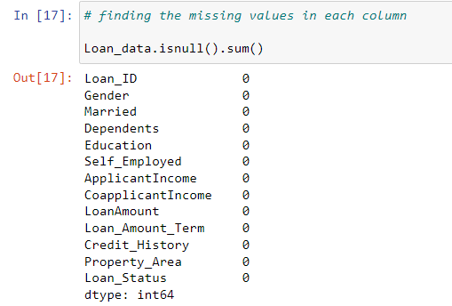
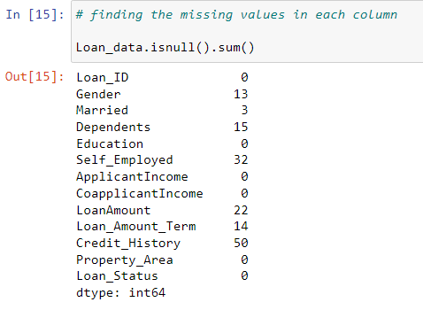

Missing Value:

Slide 9
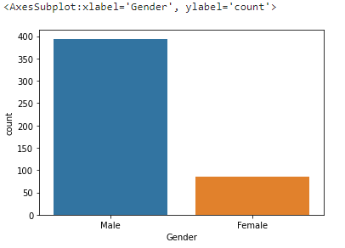
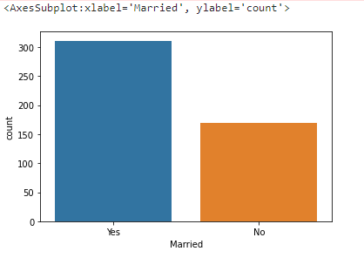
Univariate analysis: Analysis of gender variable Analysis of Married column sns.countplot(Loan_data["Gender"]) sns.countplot(Loan_data[“Married]) * Around 80% of the applicants are male * Around 65% of the applicants are Married.
EXPLORATORY DATA ANALYSIS

Slide 10
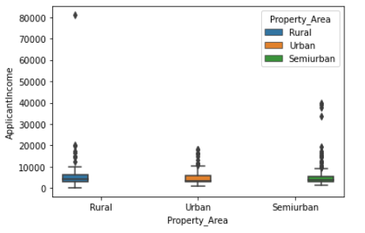
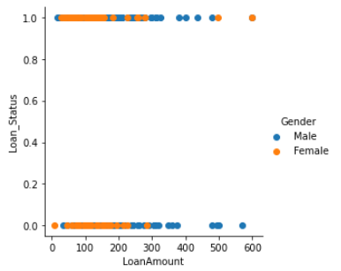
Bivariate Analysis: sns.boxplot(x=‘Property_Area’, y=‘ApplicantIncome’ , sns.FacetGrid (Loan_data,hue = "Gender",height = 5) \ hue=‘Property_Area’, data=Loan_data) map(plt.scatter , "LoanAmount“ ,” Loan_Status”) \ .add_legend() plt.show() * The graph represents the minimum, 1st quartile ,median, * Male applicants with good income have higher rate 3rd quartile and maximum values. of loan approval compared to female applicants.

Slide 11
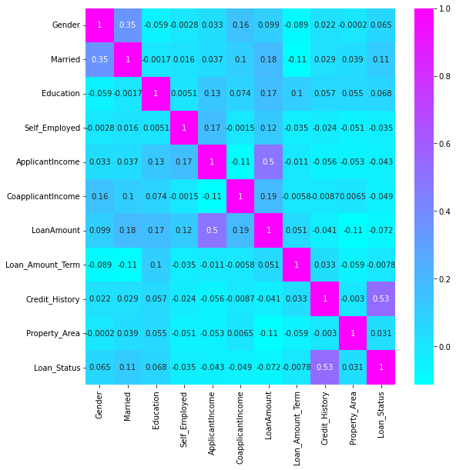
Correlation Matrix:
corr=Loan_data.corr() plt.figure(figsize=(9,9)) sns.heatmap(corr,annot=True,cmap=‘cool’)
From the above graph it is clear that applicant income and loan amount have significant relationship.
And also Credit history and Loan status have significant relationship.

Slide 12
Result and Discussion:
Machine Learning: Machine Learning is the branch of study that makes the uses of Algorithms for computer to learn from the data and improve its accuracy by itself through experiences. Classification: Classification algorithms are mainly used to identify the category of any given dataset and predict the output for the absolute data. Classification Algorithms: 1. Support Vector Machine(SVM) 2. Logistic Regression.

Slide 13
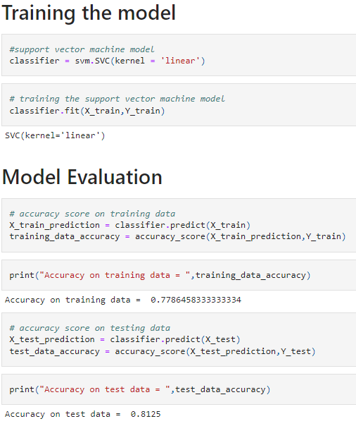
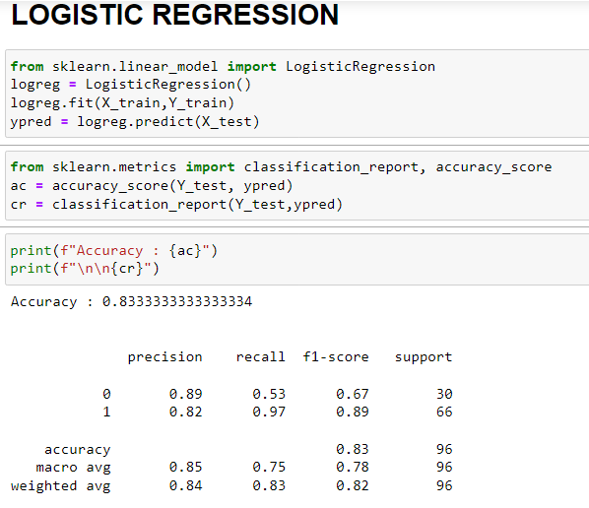
MODEL BUILDING
SVM (Support Vector Machine)
LOGISTIC REGRESSION
Logistic regression algorithm gives us better accuracy when compared to SVM algorithm.

Slide 14
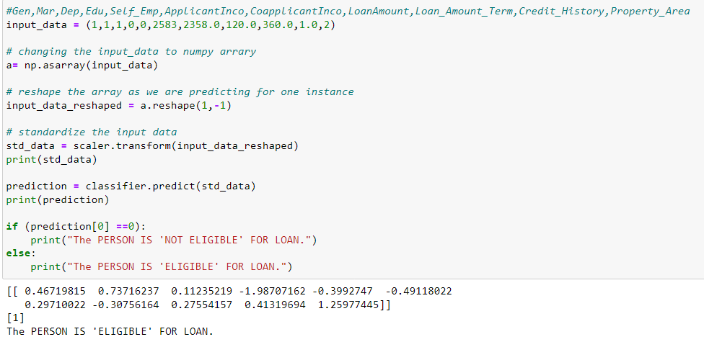
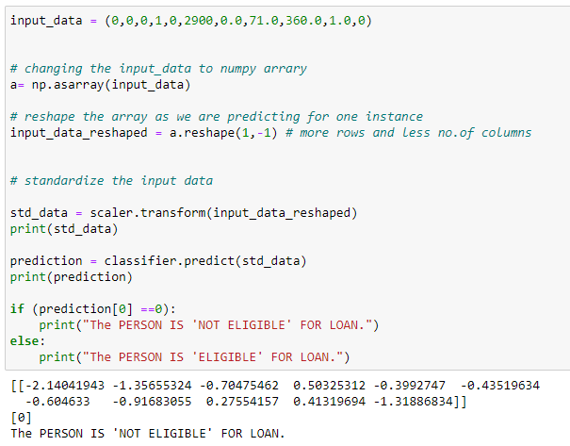
PREDICTIVE WITH UNKNOWN DATA
#Gen,Mar,Dep,Edu,Self_Emp,ApplicantIncm,CoapplicantIncm,LoanAmount,LoanAmount_Trem,Credit_History,Property_Area

Slide 15
Conclusion:
We Understood the data. We Explore the data on the features of this dataset and get the insights of the data. Credit History plays a huge role in loan status compared to other variables. We go through the machine learning algorithms like SVM and Logistic Regression are understood, how they work. Finally we build a machine learning model, to check for the unknown data and predicted whether the person will get loan or not.

Slide 16


